Slide 1






Zero-Trust
100% On-Premise • Air-Gapped
CloverShield
Lightning Fast
<200ms Latency • 100% Uptime
SOVEREIGN AI
AI to Your Data
Not Data to Cloud
Hybrid Fraud Scanner
AI + Rules • BFIU Compliant
BANGLADESH'S FINANCIAL FUTURE
Protecting ৳60,000Cr Annual Transactions
Rajshahi
Clover Crew

Slide 2



BANGLADESH
PARADOX
DATA PRIVACY VS. AI NEEDS
CLOVERSHIELD CAPTURES
Legacy Systems
Cloud SaaS
High Privacy
Low Privacy
Low AI
High AI
Data Sovereignty
BD Bank Acts • National Laws • Privacy Risks
CLOVERSHIELD
Manual
High Privacy
AI Requirements
Med Privacy
Low AI
High AI
Massive Data • Real-Time • Cloud Defaults
The Gap
100%
Hybrid Engine
BFIU Ready
Outdated Rules • Manual Bottlenecks • Zero AI
BD Laws Compliant
AI+ Policy
Compliance

Slide 3
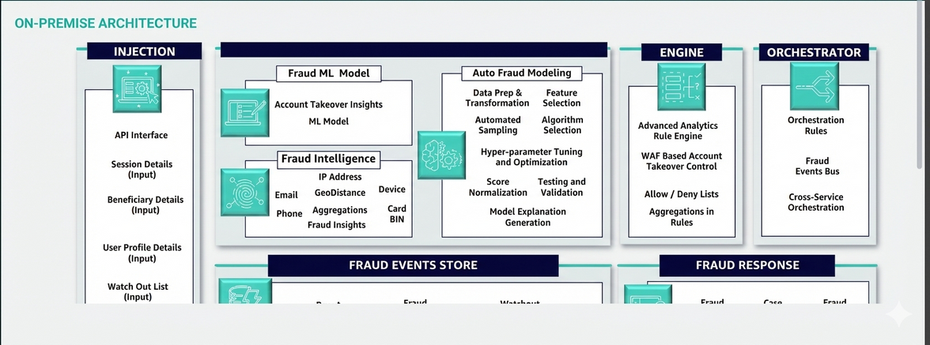





ON-PREMISE ARCHITECTURE
SOVEREIGN
AI
YOUR DATA, YOUR RULES
Real-Time Detection
Models trained on your data
Network Investigation
Cloud AI
CloverShield
Visualize money laundering rings
Data leaves premises • External APIs • Risk
Inside firewalls • Zero external calls • Safe
Rule Sandbox
<200ms
100%
EN+BN
Backtest policies safely
Latency
Uptime
Bilingual
Compliance Built-In
Audit logs • BFIU SAR

Slide 4
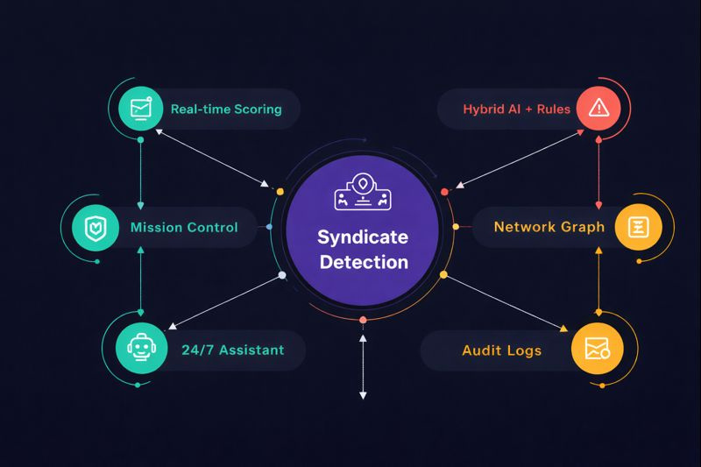




SYNDICATE DETECTION
CORE MODULES
Complete Investigation Loop
Mission Control
Real-time Scoring
Fraud Scanner
Hybrid AI + Rules
Customer 360
Network Graph
Policy Lab
Rule Sandbox
AI Copilot
24/7 Assistant
Compliance
Hybrid Engine
SHAP
Graph
Audit Logs
AI+ Policy
Explainable
Features

Slide 5
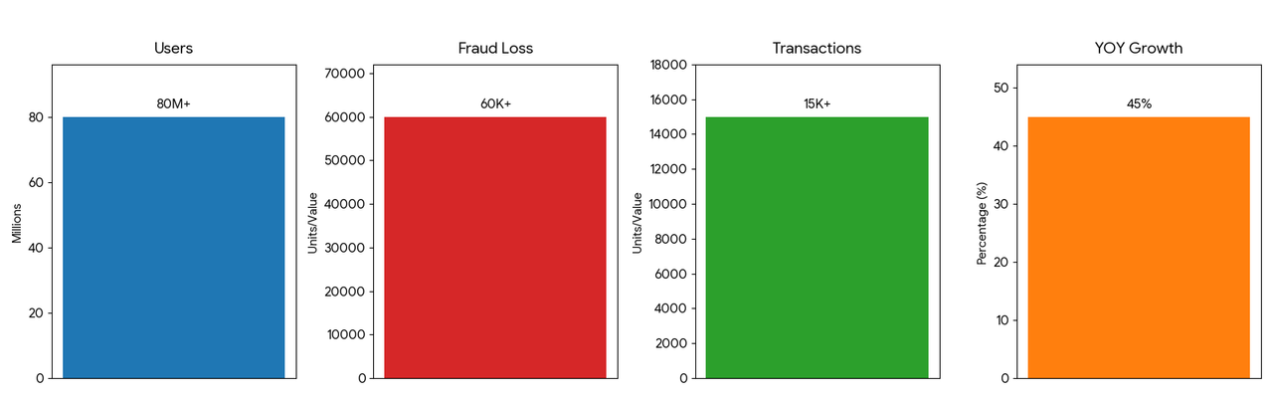



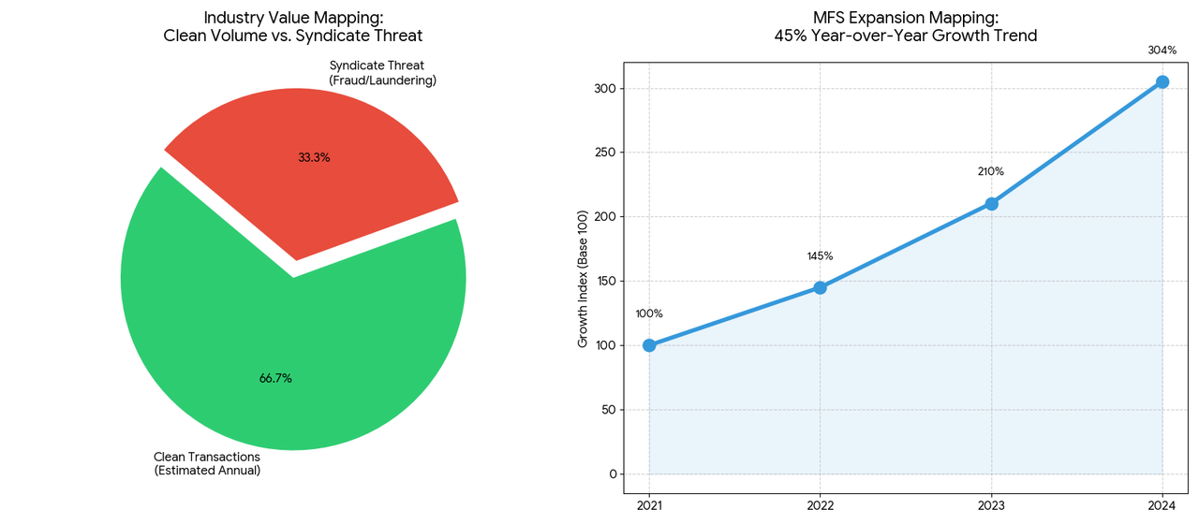


TRANSACTION GROWTH
BANGLADESH
MFS MARKET
MASSIVE SCALE • GROWING THREAT
80M+
৳15K+
Syndicate Threats
BFIU Compliance
USERS
MONTHLY TXNS
Coordinated attacks rising
Bangladesh Bank Acts tightening
৳60K+
45%
FRAUD LOSS
YOY GROWTH

Slide 6






COMPETITION
FEATURE COMPARISON
Why CloverShield Wins
100% On-Premise
LEGACY SYSTEMS
CLOUD SAAS
CLOVERSHIELD
Data never leaves your infrastructure
<200ms Latency
LAN speed, zero internet dependency
BD Law Compliant
>500ms
>500ms
<200ms
Fully compliant with data sovereignty acts
One-Command Deploy
Dockerized, <5 minute setup
High
High
Low Flat
Bilingual Support
English + Bangla localization
Unique Position: High Privacy + High AI
Low Flat Cost
Capturing the empty quadrant in the market
No recurring API fees, own your infrastructure

Slide 7





ROADMAP
From MVP to National Scale
KEY ACHIEVEMENTS
Dockerized
Policy Lab
Q1'26
MVP Ready
DONE
Q2'26
Hybrid Engine
100%
Enterprise
IN PROGRESS
AI+ Policy
On-Premise
Q3'26
Federated
Ready for Immediate Deployment
Bangladesh MFS Sector • Production-Tested • Air-Gapped
2027+
National

Slide 8


CLOVER CREW
RAJSHAHI • BANGLADESH
XGBoost + SHAP
Graph Neural
Docker + FastAPI
Explainable AI
Network Analysis
Enterprise Stack
Financial Crime
Enterprise Security
Multi-Disciplinary Team
Domain Knowledge
Zero-Trust Architecture
Data Scientists
ML Engineers
Full-Stack Devs
Fraud Analysts
National AI Build-a-thon 2026 (MXB2026)

Slide 9
TOGETHER WE CAN
BUILD SOVEREIGN DEFENSE
100%
Hybrid Engine
BD Laws
BFIU
On-Premise
AI+ Policy
Compliant
Ready
Protecting Bangladesh's Financial Future with AI-Powered, Zero-Trust Fraud Detection
LET'S BUILD BANGLADESH'S
SOVEREIGN DEFENSE
Rajshahi, Bangladesh
Clover Crew

Slide 10
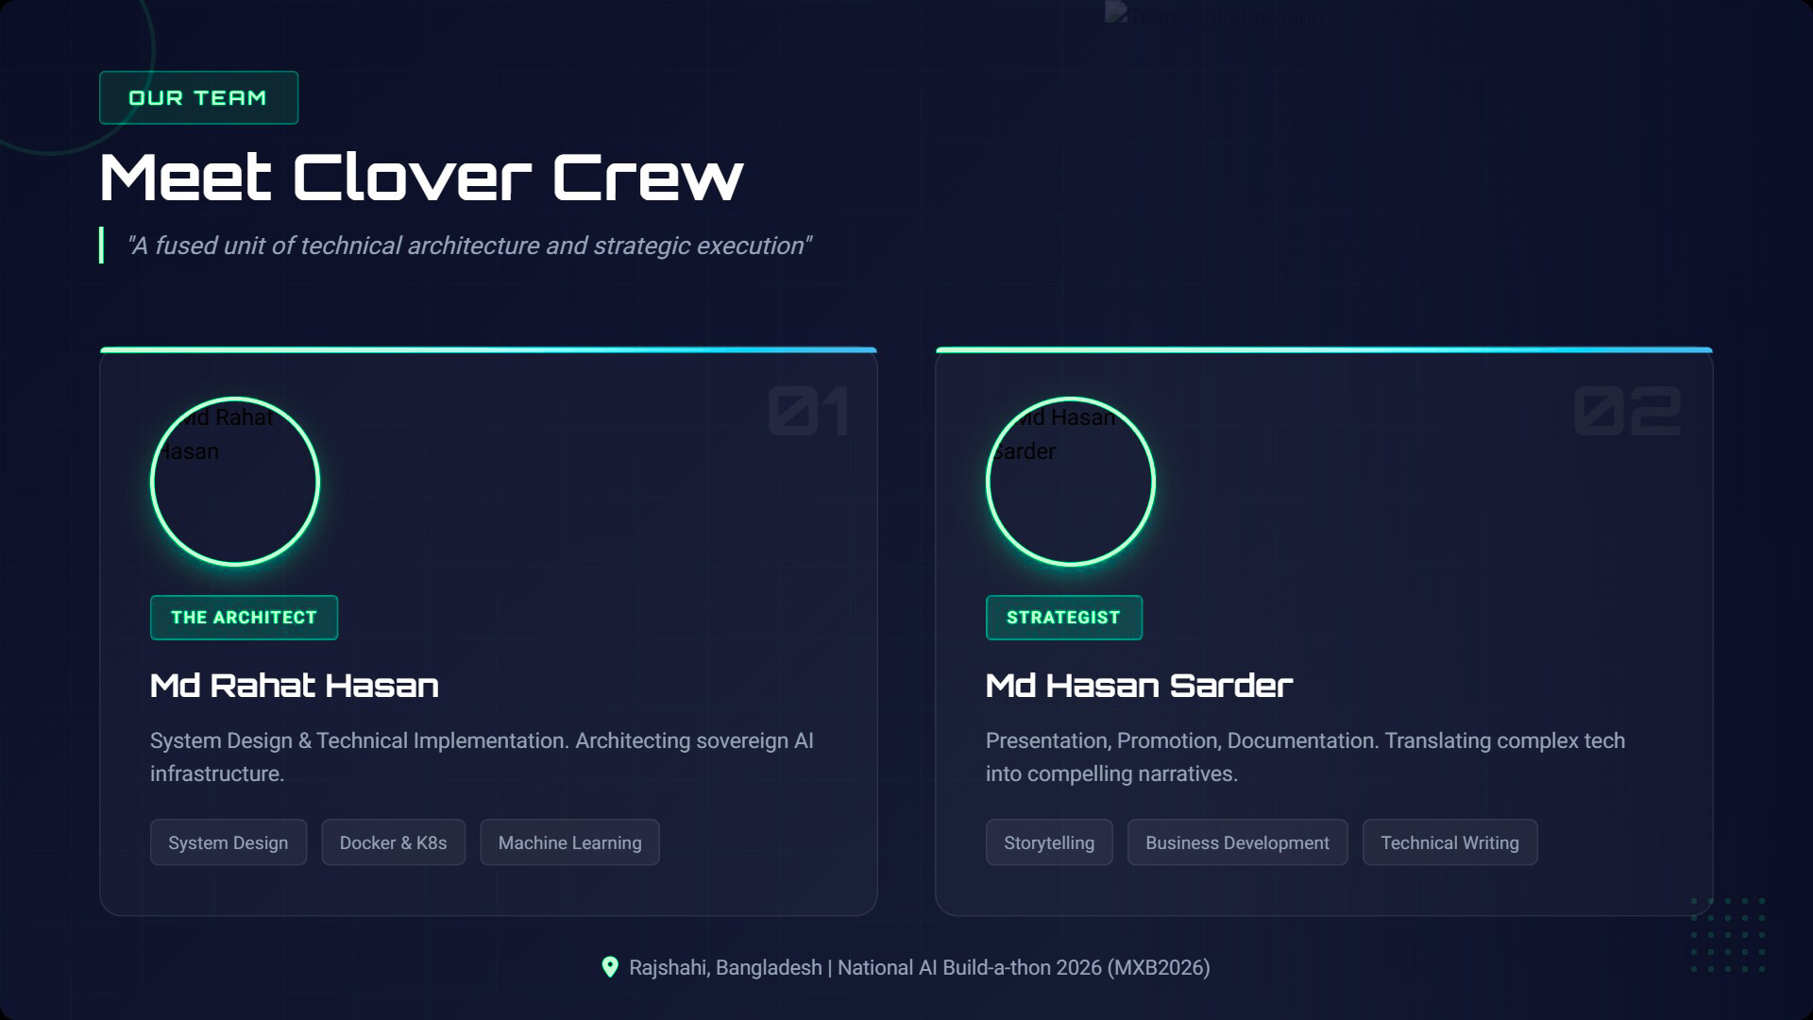
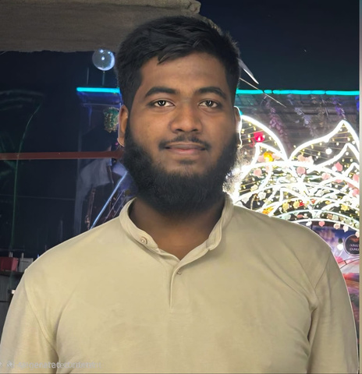
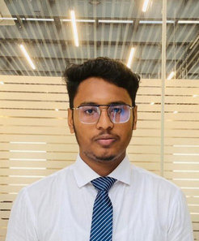
(Team Leader)

Slide 11
